Slide 1


Intro to GraphDBs
Brief introduction to graph DB concepts

Slide 2


















Boston Code Camp 27 - Thanks to our Sponsors!
Platinum
Gold
Silver
Bronze
In-Kind Donations
Notes:
First, I wanted to give a big thanks to our sponsors. They make events like these possible, so thank you!

Slide 3
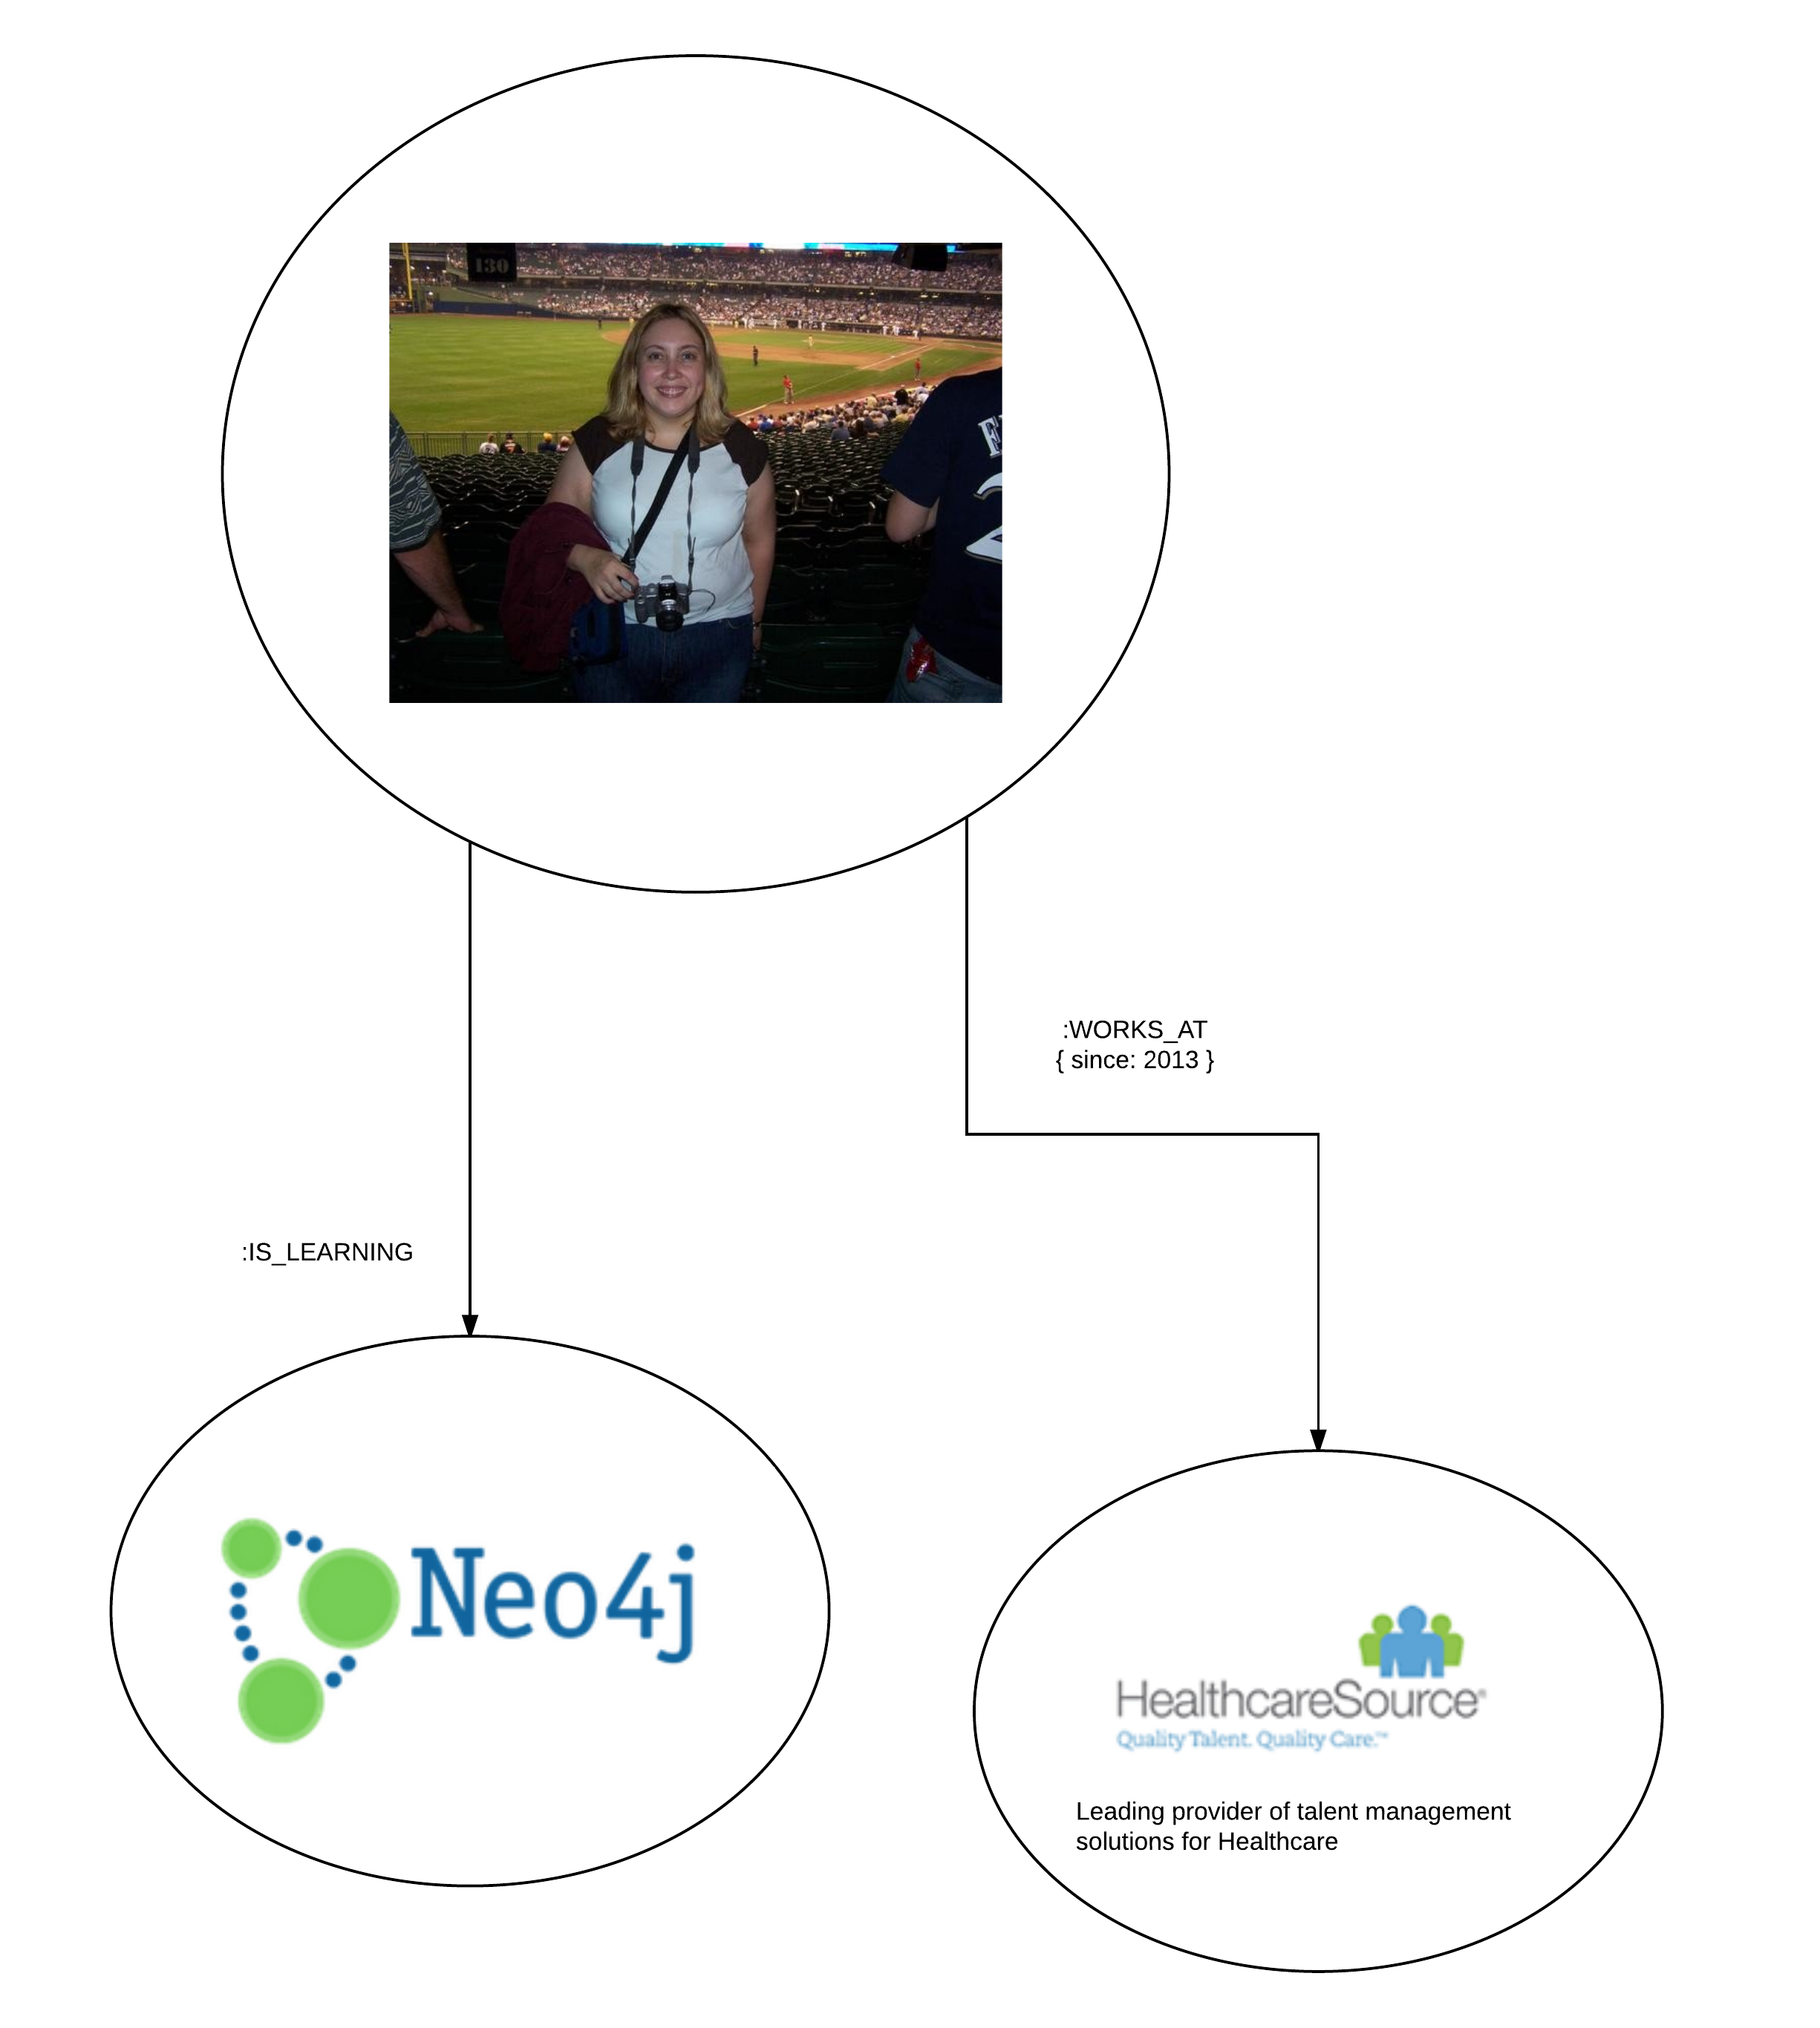
About Me
CREATE p = (person:Person {name: 'Jen',
email: 'jenparker1975@gmail.com',
github:'https://github.com/jenparker1975'})
– [:WORKS_AT {since: 2013}] -> (company:Company {name: 'HealthcareSource',
tag: 'Leading provider of talent management solutions for Healthcare' })
RETURN p
MATCH (person:Person {name: 'Jen'})
CREATE (person) -[:IS_LEARNING]->(technology:Technology {name: 'Neo4j'})
Notes:
Talk about my career a little bit – almost 20 years experience in development, most of that full-stack – gravitate toward back end
Started looking at data modelling outside the scope of relational databases a few years ago – started with full text search and elastic search, evolving to nosql databases and now to graph dbs

Slide 4
agenda
What’s a graph DB anyway?
Core Concepts
DBs with Benefits…
Popular GraphDB Engines
Complex Use Cases
Diabook – Social Network
Building the Network
Questions/Links

Slide 5
What’s a GraphDB Anyway?
Notes:
Not a pie graph or chart
Not reporting
Talking about modelling the data as nodes and relationships

Slide 6
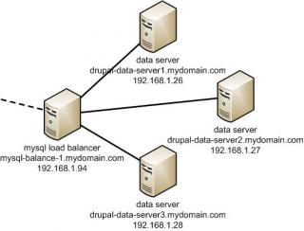
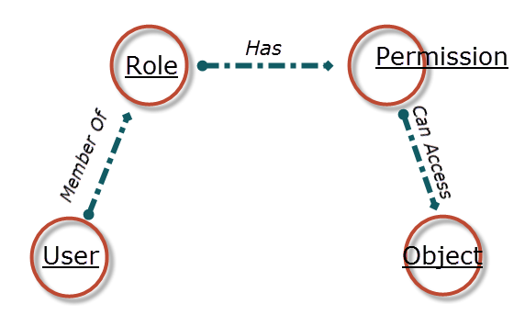
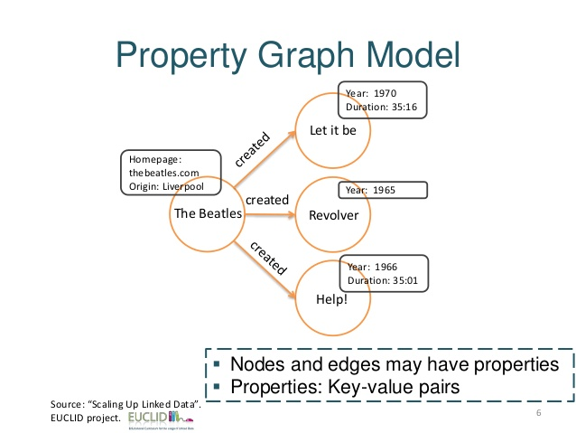
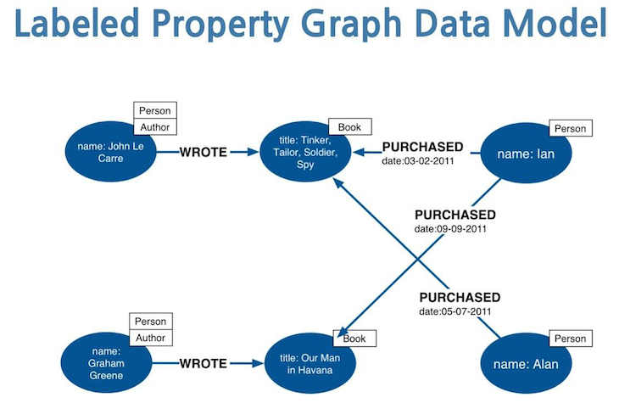
Graphs are everywhere!
Notes:
Illustrate the various uses of graphs
Talk about white boarding and object modelling as a natural precursor to graph DBs

Slide 7
So, What is a GraphDB?
Data model is represented by nodes and relationships
Uses graph structures to semantically represent objects and relationships
Relationships are first class citizens and can have properties on their own
Allows simple and fast retrieval of complex hierarchical structures
Directly relates data items in the store to allow data to be linked together
Notes:
Talk about relationships being emphasized and relationships having their own properties

Slide 8
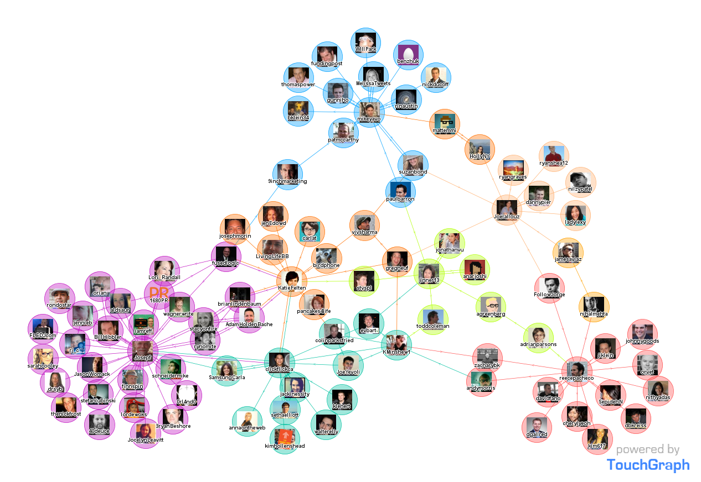
Typical Use Cases
Social Networks
Recommendations engines
Path Finding (How do I get from x to y in the shortest path)
Network Topology diagrams
Notes:
Facebook, Linked in
Path finding – airline hubs and routes – how do I get from Boston to San Diego in the shortest path? What’s the quickest driving route between here and New York City? Also, linked in – how do I connect with person A in company x – how many connections do I have to make to get to that person?

Slide 9
Core concepts

Slide 10
Building blocks
Nodes
Relationships
Properties
Labels
Notes:
Nodes – also sometimes called Vertices
Relationships – also sometimes called Edges

Slide 11
Nodes
Nodes represent entities and complex types
Nodes can contain properties
Each node can have different properties

Slide 12
Relationships
Every relationship has a name and direction
Relationships can contain properties, which can further clarify the relationship
Must have a start and end node
Notes:
Best practices – create one relationship in one direction between node a and b but query without that direction if needed – why? Because otherwise, you have to have two relationships, between a and b and b and a

Slide 13
Properties
Key value pairs used for nodes and relationships
Adds metadata to your nodes and relationships
Entity attributes
Relationship qualities

Slide 14
Labels
Used to represent objects in your domain (e.g. user, person, movie)
With labels, you can group nodes
Allows us to create indexes and constraints with groups of nodes

Slide 15
DBs with Benefits…
GraphDBs focus on relationships over normalization

Slide 16
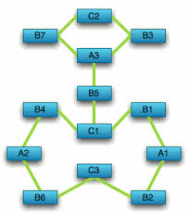
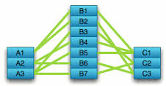
Graph DB vs Relational DB
Graph DB
Relational DB
Notes:
Relational – data in tabular format – focused on making sure there is no duplicate data – making querying costly
Graphs – focus on the connections, making path finding and querying straight forward

Slide 17
Graph Databases: Pros and Cons
Pros:
Cons:
Easy to query
Ability to connect disparate data easily without needing a common data model
Requires a different way to think about data
No single graph query language
Notes:
Cons – instead of looking at data as 3rd normal form with all your candidate keys and foreign keys, you have to start thinking about the data in terms of its interconnectivity.
Cons – Cypher, tinkerpop, Gremlin, SPARQL

Slide 18
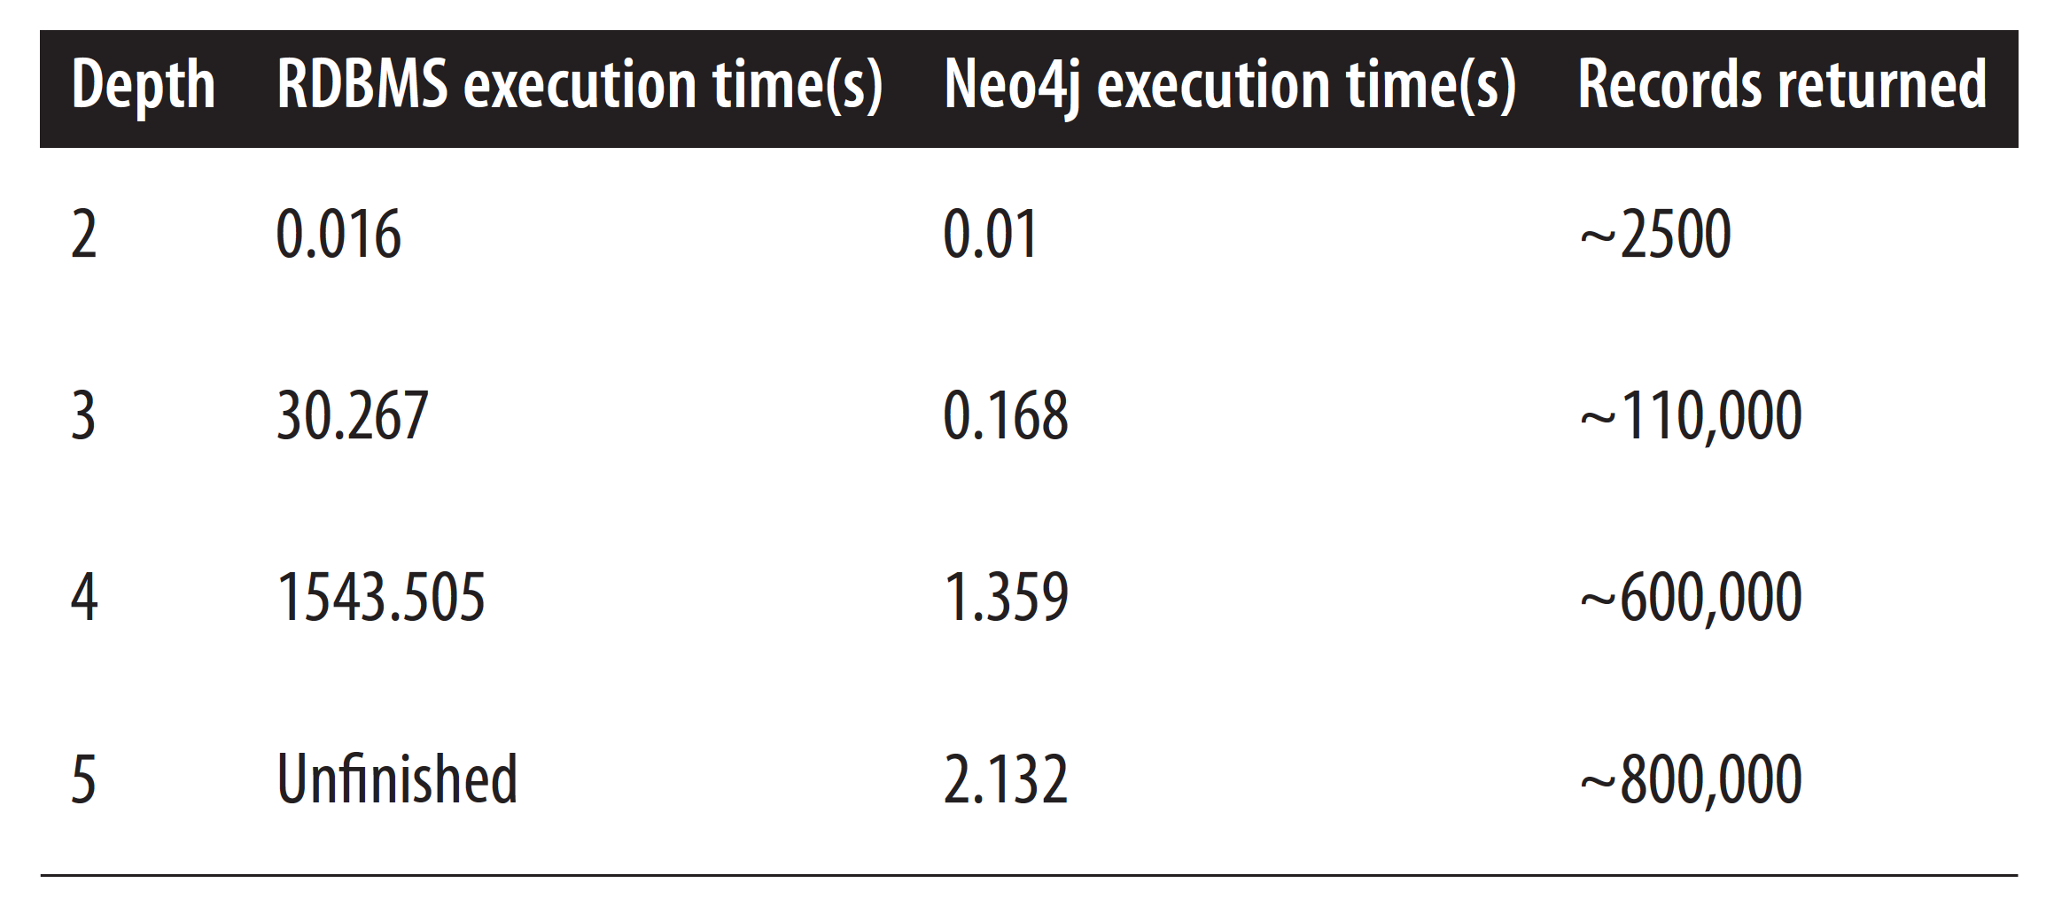

Slide 19
Popular graphdb Engines

Slide 20


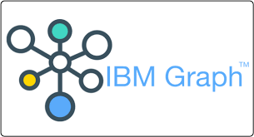
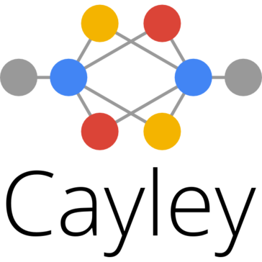
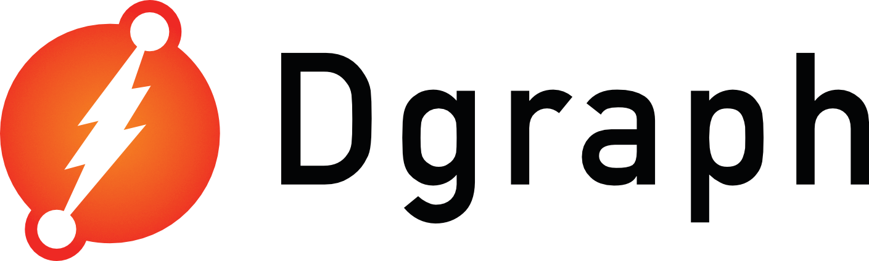




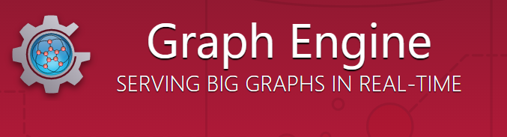
Notes:
As you can see there are many different graph DB players in the market. I’m going to compare a few of them next, but there are many others out there as well.

Slide 21
Pros:
Runs complex distributed queries
Scales out through sharded storage
Returns data natively in JSON, making it ideally suited for web development
Written on top of GraphQL
Cons:
No native windows installation
No support for windows in a production environment
Notes:
GraphQL – a query language for your API
Pros – Up and comer
Cons – not mature, not a lot of community support, and absolutely no ability to run it in Windows in production.

Slide 22
Pros:
Multi model DB – both graph and document DB
Easily add users/roles
Supports multiple databases
Cons:
No native windows service installation
Requires more schema design up front
Notes:
Cons – need to wrap the java application in something like Procrun in order to run as a windows service – no production support for windows service installation

Slide 23
Pros:
Runs on Windows natively - in either a console or as a service
24/7 production support since 2003 – Mature
Large and active user community
Cons:
Only one DB can be running on one port at a time
Notes:
Pros – you can find answers easily, very mature, there are yearly neo4j conferences available and lots of training options
Cons – means you cannot segment your data at the database level. If you need that kind of segmentation, you need to create root nodes and query based on your root nodes.

Slide 24
What does Neo4j provide?
Full ACID (atomicity, consistency, isolation, durability)
REST API
Property Graph
Lucene Index
High Availability (with Enterprise Edition)
Notes:
Lucene index – elastic search and solr
REST API – all crud operations can be performed using the REST API or one of the SDKs available.

Slide 25
Consider using Neo4j, if you’ve ever done any of the following:
Written a recursive CTE
Had a Parent Id as a self-referencing foreign key in a table
Joined more than 7 tables together
Needed to relate disparate, non-uniform data
Notes:
CTE or cursor or stored proc
Self – joins, hierarchical data

Slide 26


“Neo4j helps us to understand our online shoppers’ behavior and the relationship between our customers and products, providing a perfect tool for real-time product recommendations.... As the current market leader in graph databases, and with enterprise features for scalability and availability, Neo4j is the right choice to meet our demands. It suits our needs very well.” – Marcos Wada, Software Developer, Walmart
“Our Neo4j solution is literally thousands of times faster than the prior MySQL solution, with queries that require 10-100 times less code. At the same time, Neo4j allowed us to add functionality that was previously not possible.” – Volker Pacher, Senior Developer, eBay

Slide 27
More complex Use Cases

Slide 28
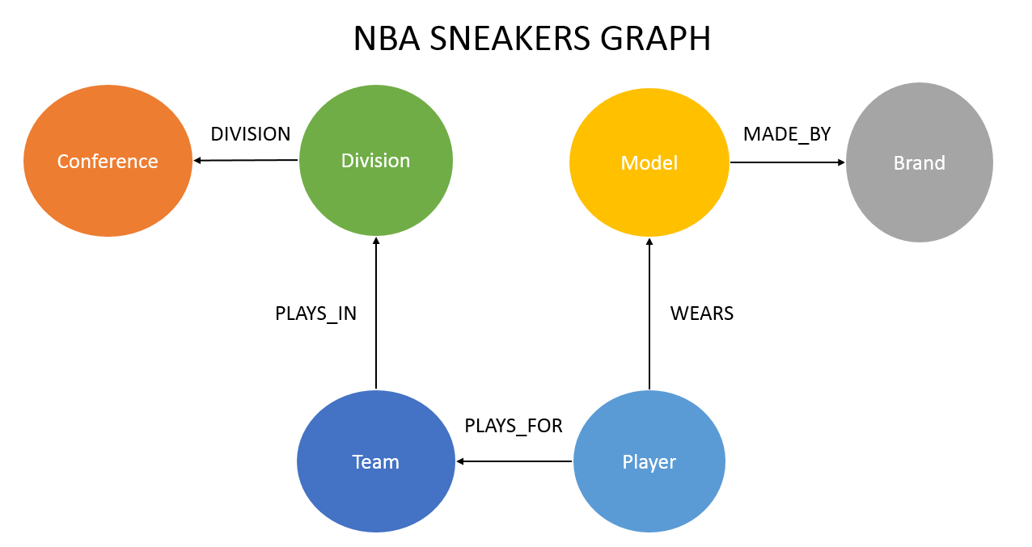
NBA Sneakers
https://neo4j.com/graphgist/52ce6522-605e-4721-9ffe-706d252ffb5c#listing_category=sports-and-recreation
List the top 5 brands worn by NBA Players
MATCH (n:Brand)-[*2]-(p:Player) WITH n.name AS brand, count(DISTINCT p) AS numberOfPlayers RETURN brand, numberOfPlayers ORDER BY numberOfPlayers DESC LIMIT 5;

Slide 29
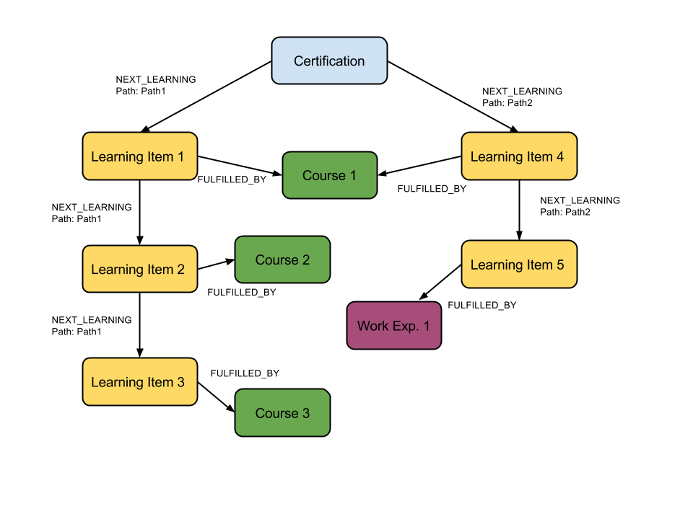
Organization Learning
https://neo4j.com/graphgist/a123a6fc-d881-4206-b42a-f864b7bfbbd3
What courses do I have to take to get my Certification?
MATCH (c:Certification {name:“Certification"})-[:NEXT_LEARNING]-> (learning:LearningItem)-[:FULFILLED_BY]->(course:Course) RETURN course.name

Slide 30
Fraud detection
https://neo4j.com/graphgist/9d627127-003b-411a-b3ce-f8d3970c2afa#listing_category=fraud-detection
How many account holders have duplicate contact information?
MATCH (accountHolder:AccountHolder)-[]->(contactInformation) WITH contactInformation, count(accountHolder) AS RingSize MATCH (contactInformation)<-[]-(accountHolder) WITH collect(accountHolder.UniqueId) AS AccountHolders, contactInformation, RingSize WHERE RingSize > 1 RETURN AccountHolders AS FraudRing, labels(contactInformation) AS ContactType, RingSize ORDER BY RingSize DESC
Notes:
The with clause allows query parts to be chained together, and passed the results on in the query
Collect – collects values into a list
Unwind transforms back into individual rows
Labels – returns a string representation for the labels attached to a node as an array

Slide 31
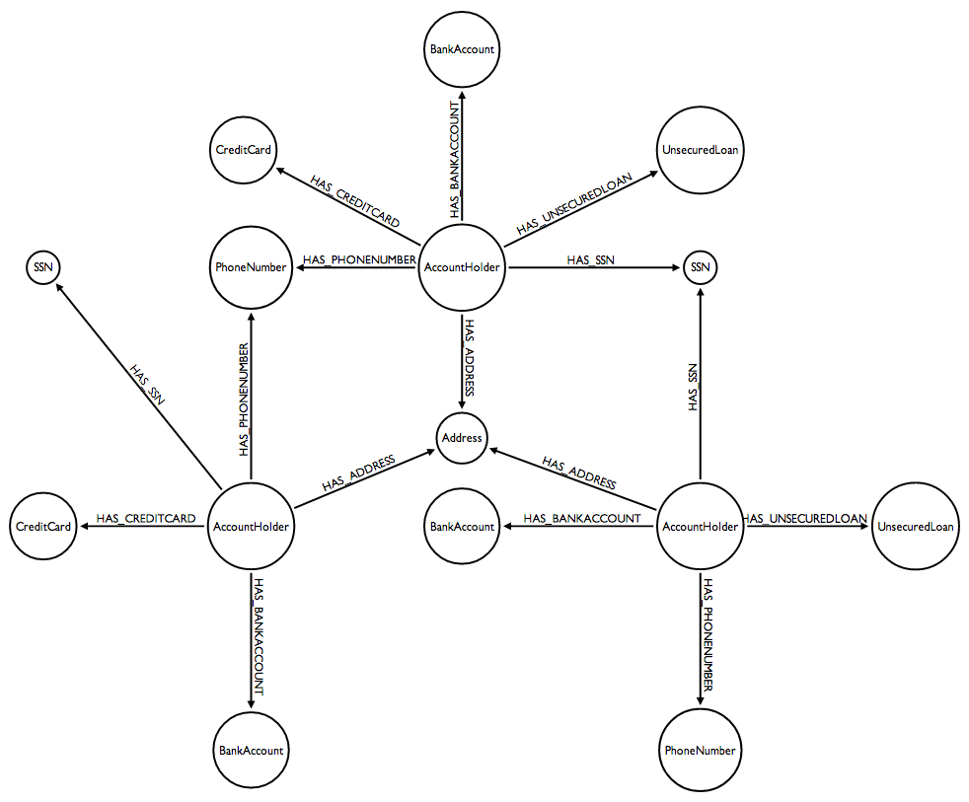

Slide 32
Diabook – social network
Example using Type 1 Diabetes
Disclaimer: all data presented is fictional
Notes:
Describe the problem:
I want to create a social network of people that have Type 1 diabetes. This should allow them to connect for support and to share what’s working for them and not working for them. I want to be able to connect to friends-of-friends that have Type 1 diabetes and also keep track of where people are being seen and what medications they are taking.

Slide 33

You can’t model that (ish) in SQL
The SQL becomes more complex as the length of the relationships increase
Performance on the joins becomes an issue quickly
SQL is not well-suited to model rich domains
It’s not easy to start at one row and follow relevant relationships along a path

Slide 34
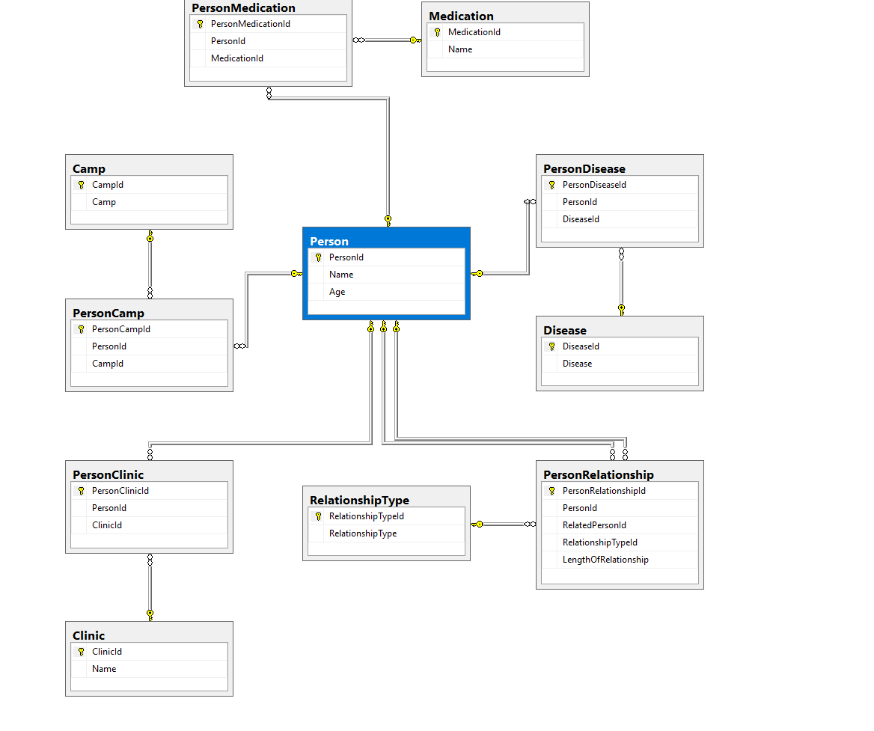
SQL Model

Slide 35
Find Friends of friends that have Type 1 diabetes
SELECT
Me.PersonId AS MeId,
Me.Name,
FriendOfFriend.RelatedPersonId AS SuggestedFriendId,
FriendOfAFriend.Name
FROM
Person AS Me
INNER JOIN
PersonRelationship AS MyFriends
ON MyFriends.PersonId = Me.PersonId
INNER JOIN
PersonRelationship AS FriendOfFriend
ON MyFriends.RelatedPersonId = FriendOfFriend.PersonId
INNER JOIN
Person AS FriendOfAFriend
ON FriendOfFriend.RelatedPersonId = FriendOfAFriend.PersonId
LEFT JOIN
PersonRelationship AS FriendsWithMe
ON Me.PersonId = FriendsWithMe.PersonId
AND FriendOfFriend.RelatedPersonId = FriendsWithMe.RelatedPersonId
INNER JOIN
PersonDisease
ON PersonDisease.PersonId = FriendOfAFriend.PersonId
WHERE
FriendsWithMe.PersonId IS NULL
AND Me.PersonId <> FriendOfFriend.RelatedPersonId
AND Me.Name = 'Bill'
AND PersonDisease.DiseaseId = 1

Slide 36
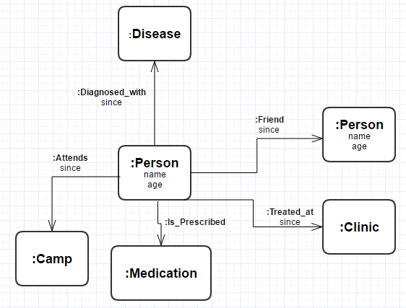
Neo4J Model

Slide 37
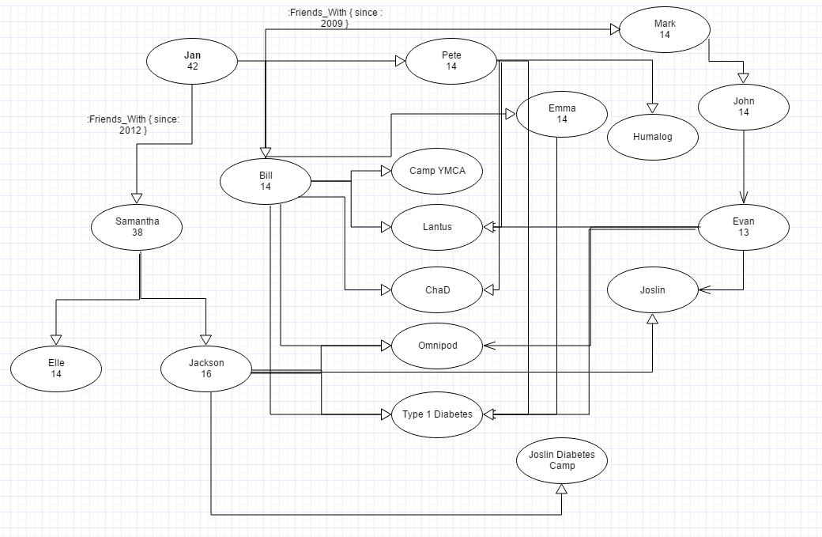
Neo4j property graph

Slide 38
Find Friends of friends that have Type 1 diabetes
MATCH (user:Person {name:'Bill'})-[:FRIENDS_WITH*2..5]->(fof)-[:DIAGNOSED_WITH]->(disease)
return fof

Slide 39
Building the network
Creating our small social network

Slide 40
Creating Nodes
Manually create nodes without relationships:
CREATE (person:Person {name: 'Jan', age: '42'}) return person
Manually create nodes with relationships:
CREATE p = (person:Person {name: 'Bill', age: '14'}) – [:DIAGNOSED_WITH] -> (disease:Disease { name: 'Type 1 Diabetes' }) RETURN p

Slide 41
Adding relationships
Add a relationship between people nodes
MATCH (p:Person {name:'Jan'}), (f:Person {name:'Samantha'})
CREATE (p)-[:FRIENDS_WITH {since: 2009}]->(f)

Slide 42
Updating node properties
Set additional properties on a node
MATCH (person:Person { name: 'Jan' })
SET person.profession = 'Software Engineer'
RETURN person

Slide 43
Deleting relationships and nodes
Deletes a relationship
MATCH ()-[r:FRIENDS_WITH]-()
DELETE r
Deletes a node
MATCH (a:Camp)
WHERE a.name='Joselin Diabetes Camp'
DELETE a

Slide 44
REST API
POST to http://localhost:7474/db/data/transaction/commit
{
"statements" : [ {
"statement" : "CREATE (n) RETURN id(n)"
} ]
}
Can be used to execute multiple statements or begin, rollback, or commit a transaction

Slide 45
Helpful links
https://neo4j.com/graphgists/ - Graph gists
https://neo4j.com/developer/cypher/ - Cypher query language
https://github.com/Readify/Neo4jClient/wiki - Neo4j Client Documentation

